Slide 1
Social & Environmental Management Project
Workshop on E&S data management
Date
Template March 2023

Slide 2
Welcome and Introductions
Please introduce yourself:
Your name
Your position
Your role in data management
One key expectation from this virtual workshop
This Photo by Unknown Author is licensed under CC BY-SA-NC

Slide 3
Who we are
Cerise is a non-profit service provider based in France, associated with SPTF, a standard-setting body
Actively promoting social performance in the financial inclusion and social business since 2001
In 2004, created Social Performance Indicators tool (SPI)
Also working on outcome management
Other organization conducting the training

Slide 4
Context
supporting purpose-driven organizations in:
Translating their mission/vision/strategy into social and environmental objectives, and into objectively and realistically verifiable indicators.
Evaluating social and environmental impact on clients, using data already available and conducting field surveys to collect additional data.
Improving social and environmental monitoring system, in order to strengthen data quality, and thus to improve the level of social and environmental analysis.

Slide 5
Context
The following work is generally conducted:
Translation of mission into S&E objectives and indicators:
4 online sessions of 2 hours on ToC
Analysis of existing data (MIS):
Organization’s datasets – active loans, disbursed loans over time, clients’ profile, etc
Organization of focus group discussions or quantitative surveys to collect outcomes data
Analysis: (a) what data say; (b) how to manage S&E data
Impact Evaluation Report + Data Protocol + Action Plan

Slide 6
Workshop objectives
This workshop aims to help internal teams on how to collect and manage high quality data from clients, in order to monitor social and environmental objectives.
Specifically, the learning objectives of this workshop are:
Understand the expected impact of the organization
Get familiar with the social and environmental objectives and indicators selected by the organization
Understand the importance of good quality data
Discuss and learn on how to ensure good quality in data management process

Slide 7
Agenda
WHY - Why managing E&S data (20 min)
WHAT - Key E&S objectives and indicators identified for the organization (20 min)
HOW - Good practices in E&S data collection and management (20 min)
Notes:
Make KRK CEO talk on why it is important for them

Slide 8
Ground Rules
Participate freely and actively – don’t hesitate
Stay away from distractions
No mobiles or laptop (other than this window) or side talks
Be respectful and courteous
Please don’t leave the desk unless it is urgent (and if you do, let us know)
Any others??

Slide 9
What is your org mission? + show the mission

Slide 10
Key results – this is your impact

Slide 11
True or fauls? 3 question

Slide 12
Why managing E&S data
WHY

Slide 13
Let’s first define some key terms
 | Key Terms | Explanation
1 | Data | Raw information collected with the idea of processing it and using it for decision making
2 | Social and environmental (S&E) data | Any data that helps an organization understand its social and environmental performance. Examples of S&E data in microfinance include: client profile (men/women, rural/urban, young, other exclusion criteria, etc.), income levels of clients, service quality related data (client satisfaction, loan/accounts dormancy, client exits, staff exits, staff satisfaction, etc), social and environmental outcomes…
3 | Data management framework / process | Data management involves a set of functions, processes and protocols around data collection, storage, retrieval, analysis and reporting
For the purpose of this workshop, we are going to focus on social data collected (directly from clients) by Financial Service Providers
Notes:
An MFI collects lots of data – for eg. Clients names, demographic profile (age, marital status, etc), transactions data, socio-economic profile (eg.poverty levels, housing conditions etc), credit history etc. This data is collected at various stages of client engagement and from various sources
Social data or social performance data - Any data that helps an organization understand its social performance, i.e., The effective translation of an institution's social mission into practice in line with accepted social values. Examples of social data in microfinance includes: client profile (men or women), poverty levels of clients, service quality related data – client satisfaction, loan dormancy, client exits, staff exits, staff satisfaction.
Social performance = सामाजिक प्रदर्शन
Social performance management = सामाजिक प्रदर्शन प्रबंधन
Data management = डाटा/ आँकड़ा प्रबंधन

Slide 14
Why do FSPs collect client data?
What do they do with it?

Slide 15
Financial Service Providers (FSP) collect a lot of client data
How is the data used?
Client Feedback
Credit appraisal
Reporting
Monitoring
Business planning
Segmentation
Impact measurement
Mission fulfilment
Product development
Customer service
Risk analysis
Provision of Services
Compliance
Product improvement
Disbursement
Understand client outreach
Client selection
Measuring Organizational Performance
Notes:
Ask participants before showing the answers

Slide 16
CEO speak on why? 5 min

Slide 17
Financial Service Providers (FSP) collect a lot of client data
Client Outreach
Income levels
Household data (# of family members, relationships, education levels, occupations, income, etc.)
Socio-demographic profile (age, gender, community/religion/caste)
Vulnerability (minority or disabled)
Financial inclusion or exclusion (whether clients have bank accounts)
Geographic information (rural, urban, district, etc.)
Typical client data collected
Client Feedback and Service Quality
Satisfaction with the organization
Reasons for client exits
Reasons for client dormancy
Awareness levels of the product and services
Complaints or grievances
Impact or outcome related
Socio-economic profile
Self-esteem
Changes in lives after getting financial services
Children’s education
Others

Slide 18
Fictive example
Data collected: Monthly family income
Active loans by monthly family income per capita
Credit appraisal
Understanding client outreach
Monitor achievement of your social objective (« reach out to people with low income »)
Conduct segmented analysis (e.g. PAR or product uptake per income level) and improve services
Report and communicate

Slide 19
Fictive example
Data collected: Age
Disbursed loans by age (nb)
Credit appraisal
Understanding client outreach
Conduct segmented analysis => showing here the need to address the higher risk by providing support to younger clients

Slide 20
Fictive example
Data collected: Rural / urban
Type of loan
Understanding client outreach
Conduct segmented analysis => to define the strategy towards maintaining rural share

Slide 21
Fictive example
Data collected: Gender
Understanding client outreach
Conduct segmented analysis => to define the strategy towards increasing the share of female clients and providing support
Monitor achievement of the social objective (« increase the share of female clients »)
Focus Group Discussions
Female clients: more deliberate in planning business development!
But feeling the need to improve their own skills

Slide 22
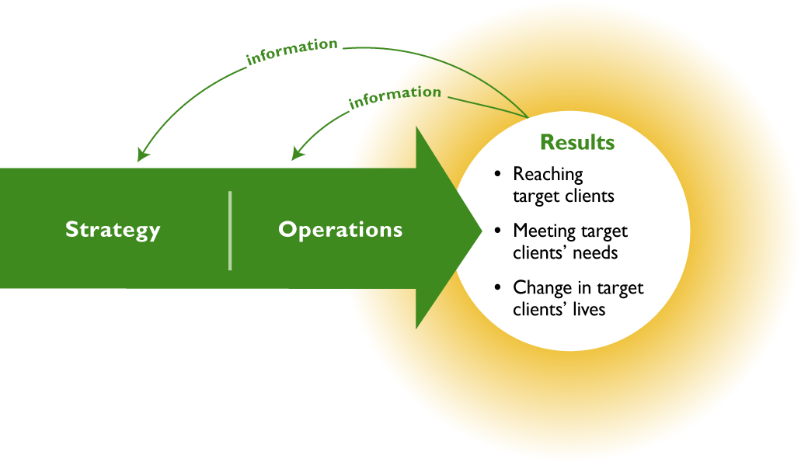
Social Performance Management Pathway
*Graphic from Imp-Act SPM Training

Slide 23
Data is important, but what about the quality of data? What does high quality data mean?

Slide 24
Defining data quality
Data quality is the ability of your data to serve its intended purpose based on 7 distinct characteristics:
Data is generally considered high quality if it “fits for [its] intended uses in operations, decision-making and planning”
- Thomas C. Redman
Accuracy
Availability
Completeness
Granularity
Relevance
Reliability
Timeliness
*Source: https://humansofdata.atlan.com/2020/02/what-is-data-quality/
Notes:
There are seven factors that play a huge role in determining data quality.
Accuracy: Is your data correct, precise, error-free? Without accuracy, your data is misleading and useless.
Availability: Is the right data available to the right people within your organization? Data has to be available and accessible for the humans of data to do their jobs.
Completeness: Is your data incomplete? Is some information missing? Incomplete data leads to gaps in information, making it harder to put data to use.
Granularity: What’s the level of detail that your data can provide? The right degree of granularity in data is necessary for accurate and effective decision-making.
Relevance: Do you know whether you really need the information that you’ve collected? What’s the purpose of the data you’ve storing? Irrelevant information just ends up wasting your time, effort and money.
Reliability: Is your data ambiguous, vague or contains contradicting information? In all such cases, the information you have is unreliable and you cannot trust your data.
Timeliness: Is your data outdated or obsolete? Data collected at the right time is an important measure of data quality. Relying on data that isn’t timely is misleading and can lead to inaccurate decisions.

Slide 25
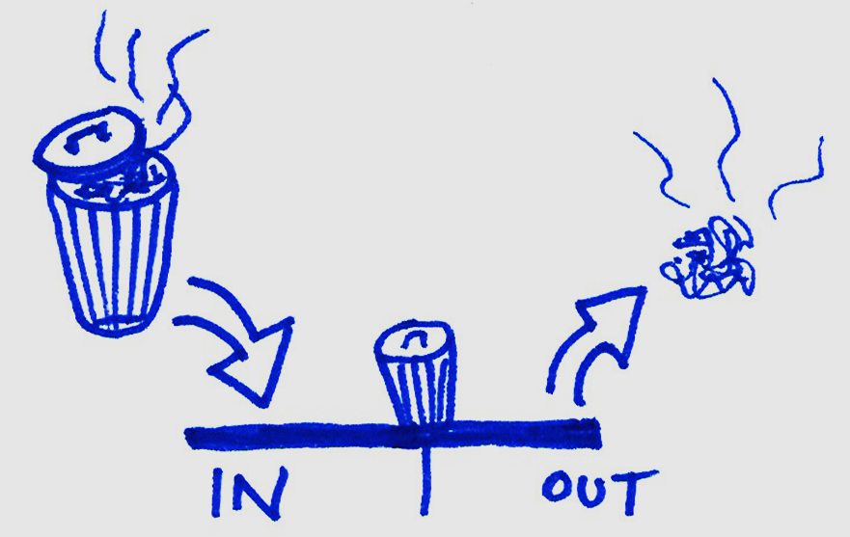
Why is good quality data important?
Correct findings can help management make appropriate decisions
Increased trust in data by the management – key for using the data
Helps clients receive good products and services
Contributes to profitability
Helps in identifying the risks / early warning triggers at the right time
Bad data means:
Costs
Wrong decisions
Loss of reputation
Decreased productivity
Garbage in – Garbage Out

Slide 26
Examples of data quality issues
Incorrect data on business sales and family income => overestimation of clients' capacity to pay => increased portfolio at risk
Incorrect data on how the loan is used according to clients' profiles => financial product not adapted to the intended purpose / inadequate marketing to target customers => loss of market share in front of increased market competition
Lack of data on why clients withdraw their savings => belief that they were withdrawing due to COVID crisis, whereas actually it was due to lack of trust in the FSP solidity => not identifying the reason and not being able to address the reputation issue => loss of reputation, loss of clients
Lack of data or incorrect data on clients' profiles (e.g. rural / urban) => Board and management do not see whether they achieve their social objectives => risk of mission drift and inadequate marketing strategy

Slide 27
Key E&S objectives and indicators
WHAT

Slide 28
List of E&S indicators
Based on the organization’s social mission and social & environmental objectives
3 types of indicators:
WHO? Target clients
WHAT AND HOW? Products and services
WHAT CHANGE EXPECTED?
Definitions provided
Lots of them already collected : what matters is ensuring data quality + analysis
Notes:
What follows is a summary of key indicators (not the exhaustive list)

Slide 29
WHO? Target clients
Understanding client outreach
Conduct segmented analysis
Objective: Reach out to people with no access to banks, with no collateral and with small and informal businesses
Indicator: % of clients with no collateral
Indicator: % of clients with informal businesses
Indicator: % of clients in micro and small businesses
Indicator: % of clients with no previous access to bank
Objective: Reach out to people with low income
Indicator: Average loan size / GNI per capita
Indicator: % clients with income per capita below € 500 [QUALITY ISSUE]
Notes:
NEW => loan application form to be updated

Slide 30
WHO? Target clients
Understanding client outreach
Conduct segmented analysis
Objective: Maintain the share of rural clients between 60% and 70%
Indicators: % rural / urban clients and portfolio
Objective: Increase the share of female clients in business by 2% compared to 2021
Indicators: % female clients and portfolio
Notes:
NEW => loan application form to be updated

Slide 31
WHAT AND HOW? Products and services
Objective: Address the needs of target clients by offering a wide range of high quality financial products
Indicators: # products; # complaints…
Objective: Maintain the loyalty of clients
Indicator: % clients with 3 and more loan cycles
Objective: Maintain good reputation in the community
Client surveys / interviews / focus group discussions

Slide 32
WHAT CHANGES? Outcomes
Objectives: Contribute to business development
Indicators: % business with increased loan size
Indicators: % businesses with increased business assets / business sales / nb of employees from one loan cycle to another [QUALITY ISSUE]
Client surveys / interviews / focus group discussions

Slide 33
WHAT CHANGES? Outcomes
Objectives: Contribute to living standards improvements
Indicators: # clients with renovation and EE loans
Indicators: % clients with increased monthly family income per capita [QUALITY ISSUE]
Client surveys / interviews / focus group discussions
Objectives: Contribute to food production by supporting agriculture businesses
Indicators: # agricultural loans

Slide 34
To summarize
Lots of these indicators are often already collected by the organization, in particular in the loan application and appraisal process
Ensure data quality and use (analyze) what you have
If needed, the organization can collect additional data of interest, through focus group discussions, follow up calls, monitoring forms, short surveys...
Choose relevant indicators, sample, data collection method, and ensure data quality

Slide 35
Good practices in E&S data collection and management
HOW

Slide 36
Data management process
Identify E&S objectives / issues
Data collection
Data entry
Data Cleaning & Analysis
Reporting
Each of you play a role at different stages to ensure quality data management!

Slide 37
Identify E&S objectives / issues
Identify E&S objectives / issues
Define data collection method
Data collection
Data entry
Data integration
Data Cleaning
Data Analysis
Reporting
What do you want to monitor and why / what for?
Not identifying the right data
Not aligning with the organization strategy
Not thinking of the whole picture
Not thinking how the E&S data will be used for decision making
What are the quality issues at this stage?
How to ensure quality?
Alignment with strategy
SMART indicators (specific, measurable, achievable, relevant, time-bound)
Clear data management plan along with commitment to use the data

Slide 38
Define the data collection method
When and how do you want to collect the data?
Integrated in the current procedures and tools: loan application form, loan monitoring form, follow-up calls
And/or through specific research (surveys, focus groups)
Identify E&S objectives / issues
Define data collection method
Data collection
Data entry
Data integration
Data Cleaning
Data Analysis
Reporting
Not integrating into current procedures and tools
Not choosing the right moment or frequency
Having questions or indicators that are too vague / subject to interpretation
For surveys or FGDs: not choosing the right research methodology, selecting the wrong sampling strategy, not designing the questionnaire well, etc.
What are the quality issues at this stage?
How to ensure quality?
Integrate E&S data collection into existing procedures and tools / use existing data
Focus on the wording of the questions
For surveys or FGDs: design carefully the research methodology (quanti/quali, sample, questionnaire, etc.)
Respect your customers (non intrusive, personal data)

Slide 39
Data collection
This includes actual data collection from the field, from clients (face-to-face, phone, forms...)
Identify E&S objectives / issues
Define data collection method
Data collection
Data entry
Data integration
Data Cleaning
Data Analysis
Reporting
Question not understood by the staff and/or the client
Taking shortcuts or making assumptions while collecting data
Client or staff fatigue if E&S data is too complex or too many
Implementation challenges (clients not available, refuses to answer the questions etc)
Different staff have different ways to answer (e.g. on estimating monthly income)
Writing down or marking wrong answers; incomplete questionnaires (eg. clients may not provide answers or the interviewer forgets to ask or capture the questions)
What are the quality issues at this stage?
How to ensure quality?
Staff training
Clear and standardized procedures
Quality control
Reasonable length of forms / questionnaires
Making the client comfortable before asking questions
Use of technology

Slide 40
Data entry
Capturing the information from paper to computer
Identify E&S objectives / issues
Define data collection method
Data collection
Data entry
Data integration
Data Cleaning
Data Analysis
Reporting
Indicator not in the MIS
Wrong data entry
Missing some entries / incomplete data
Outliers (eg. very high or low numbers)
Delayed entry (affects timeliness factor in the data quality factors)
What are the quality issues at this stage?
Integrating E&S indicators into the (new) MIS
Staff training
Quality control and cross check on a sampling basis (when the answers are coded from paper to electronic form) or cross check with the recordings and the data entered
Having appropriate data validation in the field when the data is entered
Use of technology
How to ensure quality?

Slide 41
Data integration
This basically includes merging data from various sources (eg. multiple excel sheets) into a consolidate data sheet for analysing
Identify E&S objectives / issues
Define data collection method
Data collection
Data entry
Data integration
Data Cleaning
Data Analysis
Reporting
Errors in merging
Incomplete or gaps while merging
Different formats (this will come up when there is more open ended data entry formats – eg, someone will type 1, other might type one)
Various spelling errors
What are the quality issues at this stage?
Centralizing all E&S data on the MIS to avoid having multiple files to analyze
Clear and standardized procedures
Staff training
Quality check and standardization of data at the time of data entry and integration
How to ensure quality?

Slide 42
Data cleaning
Data cleaning is the process of fixing or removing incorrect, corrupted, incorrectly formatted, duplicate, or incomplete data within a dataset
Identify E&S objectives / issues
Define data collection method
Data collection
Data entry
Data integration
Data Cleaning
Data Analysis
Reporting
What are the quality issues at this stage?
Duplicate, irrelevant observations, errors, typos, outliers…
If data cleaning is not done well, the overall data quality will be affected
Training to staff who does the data cleaning
Have a clear process laid out to be followed every time. For instance, some of the steps are:
Step 1: Remove duplicate or irrelevant observations
Step 2: Fix structural errors (errors, typos, or incorrect capitalization etc)
Step 3: Filter unwanted outliers
Step 4: Handle missing data
Step 5: Validate
How to ensure quality?

Slide 43
Data analysis
Processing data using statistical or mathematical measures to derive or come up with insights.
Identify E&S objectives / issues
Define data collection method
Data collection
Data entry
Data integration
Data Cleaning
Data Analysis
Reporting
What are the quality issues at this stage?
Weak or incorrect analysis; using wrong or unclean data for analysis
Not analyzing data to optimum levels to help in decision making (e.g. for client satisfaction, if we only share the overall satisfaction rate without presenting data for other levels like branch, client profile, etc.)
Staff training on who does analysis
Using the adequate denominator
Segmented analysis (by branches, client profile)
Cross-analysis (e.g. client loyalty in light of client satisfaction)
Identification of big trends and weak signals
Involving the entire team to discuss if the insights are representative of field interactions.
How to ensure quality?

Slide 44
Reporting
Reporting includes summarizing or presenting insights to management / Board (and other stakeholders) in a manner that enables decision making.
Identify E&S objectives / issues
Define data collection method
Data collection
Data entry
Data integration
Data Cleaning
Data Analysis
Reporting
Reporting too much or too less information which doesn’t help the management or Board to use the insights from the data.
Wrong labelling or not clearly marking what the data is (eg. wrong axis notations, using misleading techniques to visualize the data, etc.)
What are the quality issues at this stage?
Correct visualization
Engage with the management / Board on how much data, in which format and how frequently data should be shared with them
Engage with the operations/business team about the results
Share the final report(s) and any decisions with the field team as well to keep them in the loop
How to ensure quality?

Slide 45
Role of monitoring and auditing
Ideally, E&S data should be verified as part of existing quality management systems. Consider using employees who already oversee information collection and reporting (e.g. branch managers, Internal Audit), but ensure that the person checking the data is not the same person responsible for entering the data.
Validating data ensures accuracy and pushes all actors in the E&S data value chain to achieve higher quality results.
Regularly and consistently validate E&S data, just as you would validate financial information. Additionally, evaluate employees on how well they adhere to the institution’s process for collecting quality E&S data. Validation techniques may include:
Visiting a random sample of clients to confirm that interviews happened
Observing the data collector in action and providing feedback on his/her performance
Verifying a random sample of data entered by the data entry personnel to confirm accuracy
Using data entry screens that will not allow the user to proceed unless certain mandatory information is entered
Using data field validation built into the technology to provide error messages when obvious inaccuracies are entered (e.g. year is 1805, or the user enters that the client has zero children in one field, but then tries to enter that the client as three children in school)
Source: Validate social data through internal controls, SEPM Guide

Slide 46
To summarize
To ensure high quality in E&S data management:
Have clear, written, standardized procedures for E&S data collection and management;
Make it simple, by focusing on key E&S data useful for decision-making and integrating E&S data collection in current activities;
Train your staff, and make sure that team members, at all levels, know about their role and responsibilities in the E&S data management cycle;
Make regular quality checks;
Use the data for decision-making;
Involve and motivate all team members by sharing and discussing the key results from E&S data analysis

Slide 47
Thank you!

