Slide 1

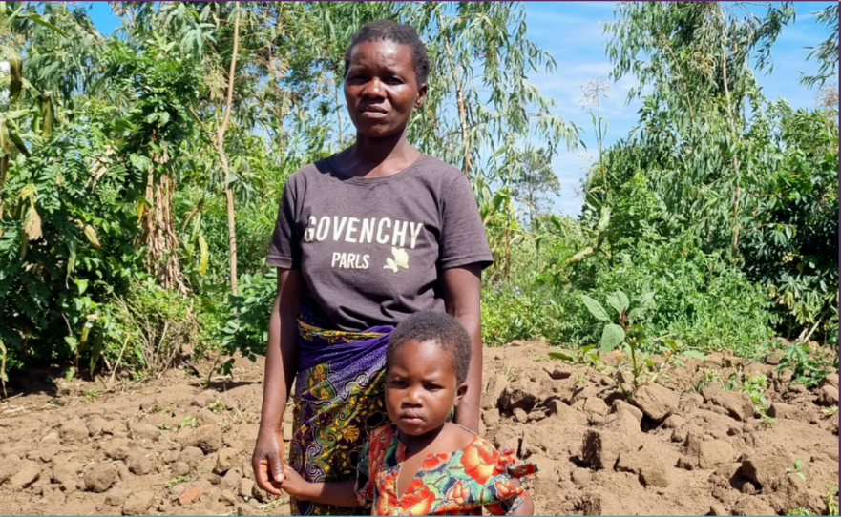

Logos FPS/Partners
Template June 2023
Social Impact
Report
FSP ABC 's contribution to the SDGs
Date

Slide 2
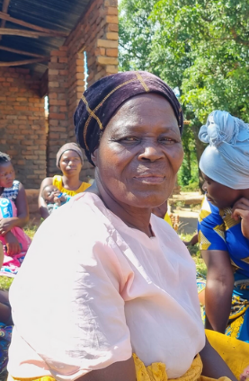
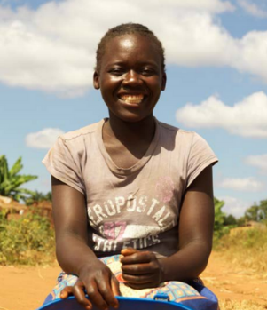
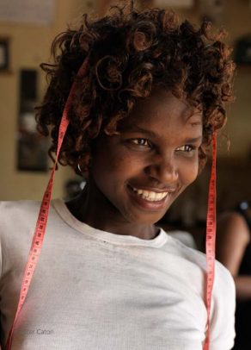
Sample of the survey
XXX clients surveyed; XXX questions; data collected on KoBoToolBox
Methodology: Ex---Clients were interviewed both in branch offices and on the field with the help of branch managers and loan officers.
Please compare sample with actual portfolio to identify any bias
Localisation
Cities: xxx (42.9%); xxx (17.9%); xxx (16.1%); xxx (12.5%); xxx (10.7%)
Zone: rural (39.3%); suburban (44.6%); urban (16.1%)
Household
Age: below 35 (xx%) – 35-50 (XX%) – Above 50 (XX%)
Marital status: married (78.5%); divorced (5.4%); widow (8.9%); single (1.8%)
At home: between 2 and 9 people; mean 5.8; standard deviation 1.7
Loan
Type: business (75%); agriculture (25%)
Activities: grow rice, selling fish, restaurant, soya beans, maize, bakery, clothes
Amount: “small loans” = (below xx in local currency) xx%, average loan xx% (between xx and xx in loc cur), large loans xx% (above xx in loc cur)
Client Seniority: % of first loan, % of second loan, % of more than 3 loans

Slide 3

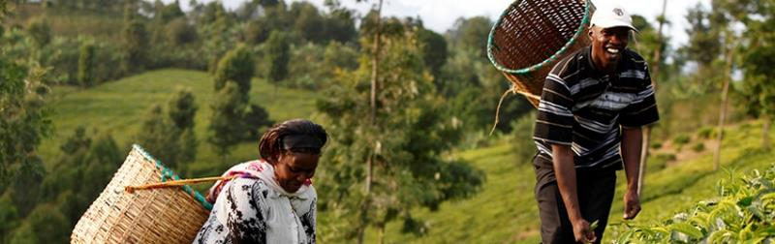


SDG 1
No Poverty
Target 1.2
AVERAGE MONTHLY HOUSEHOLD EXPENDITURE
By 2030, reduce at least by half the proportion of men, women and children of all ages living in poverty in all its dimensions according to national definitions.
xx%
of the clients witnessed an increase in their household spendings, due to:
INCOME (NUMBER OF SOURCES, CHANGE, STABILITY)
xx%
of the clients witnessed an increase in their business income
xx%
of the clients were able to increase their cash flow thanks to FMSP ABC loans and their business activity. This cash flows were mainly used to:
xx%
xx%
xx%
xx%
10.7%
xx%
xx%
xx%
xx%
7.1%
Reinvest in their business
Place into savings
Increase your liquid assets
Home improvements, basic needs, education, etc.
Inflation
Higher living standards
Devaluation of the Malawian Kwacha
Lending money to relatives, broken assets

Slide 4
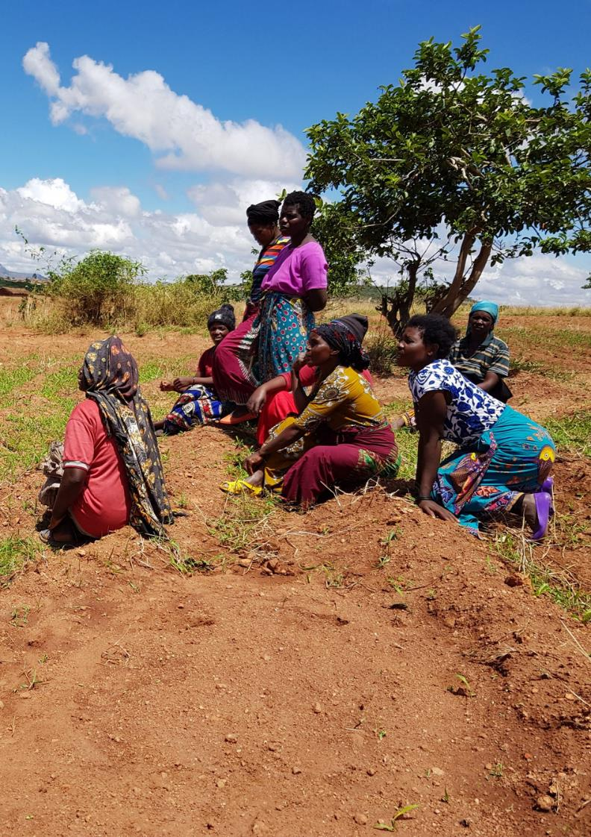

Add verbatims from the surveys, in line with SDG target
With the loan, I have proved to my community that a women can also build her house

Slide 5
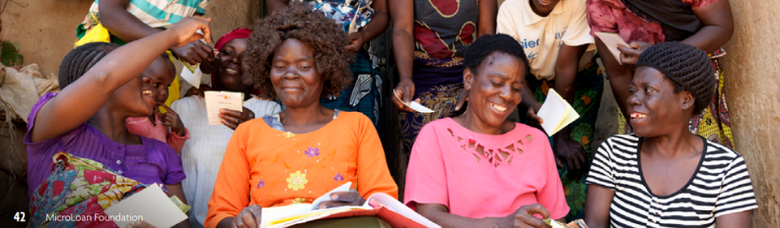
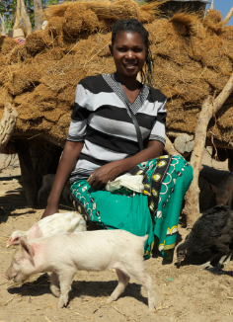
IMPROVE BASIC NEEDS
ACQUISITION OF HOUSEHOLD ASSETS
xx%
xx%
xx%
xx%
xx%
xx%
of the clients found an improvement in the acquisition of household assets: 42.9% very much, 17.9% no change, 1.79% slightly deteriorated
Segment by gender, rural/urban, age, type of loans, etc
They mainly acquired:
Bedding (18.3%%), Cooking ustensils (38.6%), Furniture (20%), Phone/4G Pocket WiFi (20%), Bicycle (14.3%), Livestock (19.6%), Housing (15.9%)
Access to toilets
60.7% very much, 7.1% not changed, 5.3% deteriorated
Access to drinking water
33.9% very much, 32.1% not changed
Cooking equipment
28.6% very much, 35.7% not changed, 5.3% deteriorated
Children education
50% very much, 21.4% not changed, 3.6% deteriorated
Healthcare
34% very much, 23.21% not changed, 7.1% deteriorated
CHANGE IN NUMBER AND QUALITY OF MEALS
ABILITY TO FACE MAJOR EXPENSE
xx%
of the clients faced a major expense recently. It was on average xxx in local currency (or % of GNI per cap), mainly because of medical/school fees and meals. Half of them report it was a heavy burden.
xx%
of the clients reported an improvement in their consumption of meat: 41% very much, 17.9% no change, 5.4% decrease
Segment by gender, rural/urban, age, type of loans, etc
To face this major expense, the clients used money from:
Savings or income (33.9%)
Other
Extra work (14.3%)
Other loan (14.3%)
Family/friends (14.3%)
xx%
of the clients experienced at least once stress or problem with the repayment of the loan
Segment by gender, rural/urban, age, type of loans, etc

Slide 6
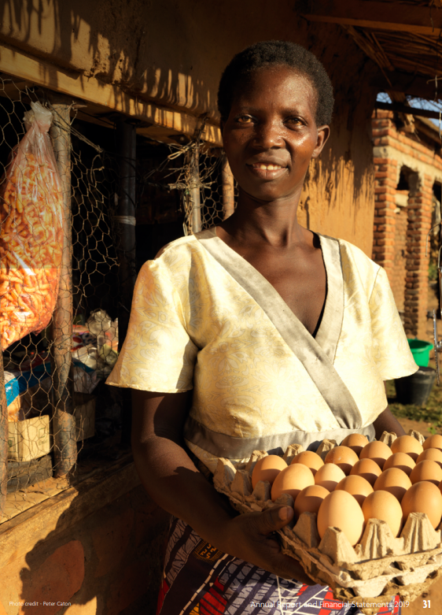






Target 1.4
By 2030, ensure that all men and women, in particular the poor and the vulnerable, have access to appropriate financial services, including Microfinance.
% CLIENTS THAT CAN BETTER MANAGE THEIR BUDGET/EXPENSES/FINANCES
Here is how clients managed their loan on average:
BUSINESS (77.8%)
Clothes
1.9%
MEALS (8.3%)
Education
5.8%
Meals
8.3%
EDUCATION (5.8%)
HOME IMPROVEMENTS (4.8%)
CLOTHES (1.9%)
HEALTHCARE (1.2%)
Business
77.7%
BASIC NEEDS (0.31%)
xx%
of the clients reported to better manage their budget, while 14.3% didn’t notice a change
Segment by gender, rural/urban, age, type of loans, etc

Slide 7
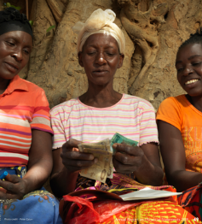
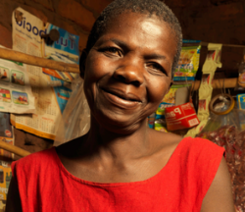
PROPORTION OF POPULATION LIVING IN HOUSEHOLDS WITH ACCESS TO BASIC (FINANCIAL) SERVICES
PERCEPTION OF CHANGE IN QUALITY OF LIFE (AND REASONS)
98.0%
xxx
of the women reported an improvement in their quality of life thanks to MLF’s loan (64.0% very much)
FSP ABC granted access to
xxx%
These are the main reasons according to them:
of the clients to their first formal loan, thus enabling them access to basic financial services
Segment by gender, rural/urban, age, type of loans, etc
Able to provide their children with basic needs (51.0%)
Feel more independent (36.6%)
Able to pay the school fees (34.0%)
Buying livestock, better clothing (28.4%)
Relief thanks to access to formal finance (13.3%)
FINANCIAL TOOLS/CHANGES IN LIQUID ASSETS
10
20
30
40
50
60
Change in clients’ savings/liquid assets:
2.0%
xx%
xx%
xx%
The rest of the women
said that their life hasn't really changed
Increase
Decrease
No change
Here is how they use the extra cash flow / savings:
I am independent and I make good business with my bakery so I can provide life needs for my family
28.6%
12.5%
41.0%
21.4%
10.7%
7.1%
Home improvements, basic needs, education...
Increase their liquid assets (livestock, jewellery...)
Place into savings
Reinvest in their business

Slide 8


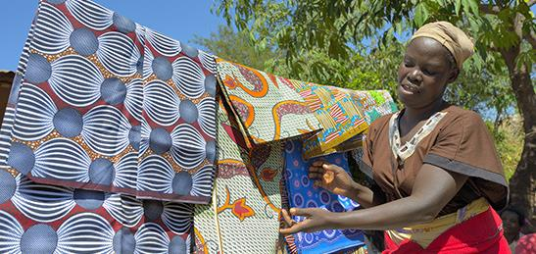
SDG 5
Gender Equality
Target 5.1
% OF WOMEN WHO REPORT THAT THEY ARE MORE COMFORTABLE VOICING THEIR OPINIONS
End of all forms of discrimination against all women and girls everywhere
CAPACITY TO MAKE DECISIONS REGARDING
THE USE OF THE HOUSEHOLDS RESOURCES
94,6%
7.6%
20%
26.6%
33.3%
5.4%
Household assets bought with the client's money by the decision of the client
xx%
More confident to voice their opinion
Group leader through the group loan
Part of a community (church, savings group)
More influence
Advice their relatives on finance
No change: already confident
xx%
of the women reported an improvement in their capacity to make decisions using household resources (31.4% very much improved - 11.1% no change - 1.8% slightly deteriorated).
% OF WOMEN WHO REPORT A PERCEPTION OF DECREASED DISCRIMINATION / EASIER ACCESS TO WORK
xx%
of the women face discrimination before taking a loan
xx%
saw an improvement

Slide 9
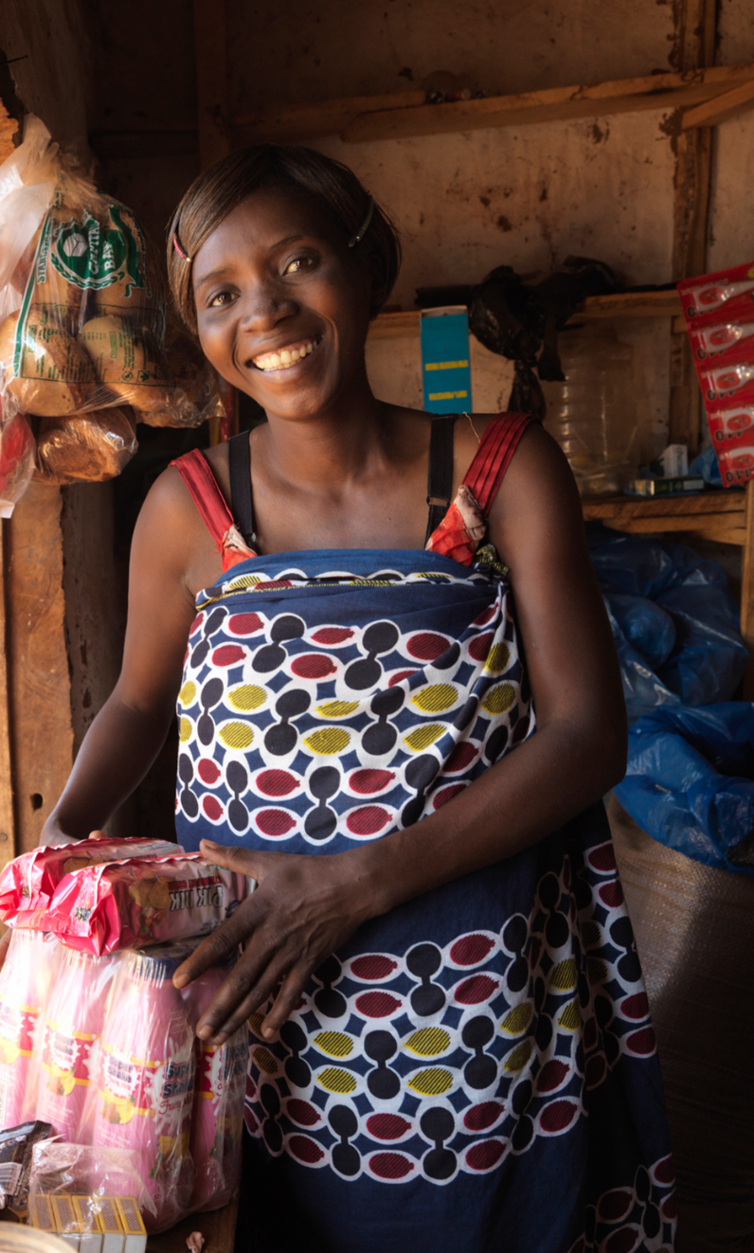

Add verbatims from the surveys, in line with SDG target
My husband was taking all the decisions, he was a little bit dominant. Now he gives me more space to voice my opinion. I am now the boss of the business so I take decisions with my husband.

Slide 10
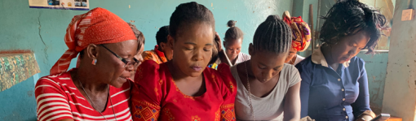
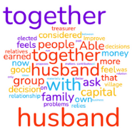


Target 5.2
Target 5.5
Eliminate all forms of violence against women and girls
Ensure women’s full and effective participation and equal opportunities for leadership at all levels of decision-making in economic life
DOMESTIC VIOLENCE
xxx%
of the women never experienced any negative aspect of the loan in their household or personal life.
CAPACITY TO USE THE LOAN FOR HER OWN ECONOMIC ACTIVITY
of the clients reported that having a loan leads to an increase in work for the household.
13%
The decision to take out a loan was made by:
The client
44,6 %
The couple
42,9 %
The husband
8,9 %
Member of the family
3,6 %
xx%
of the women feel pressure from her husband, her family or community
The husband, the community and the family know about the loan
Reasons :
Gossipping
9.1%
The loan is used by:
Extended family
6.4%
Husband taking avantage
27.3%
Discouraging her to take the loan
36.4%
Jealousy because they are prospering
18.2%
The household
37.9%
The client
55.8%
People saying that they won’t be able to reimburse their loan
45.5%

Slide 11

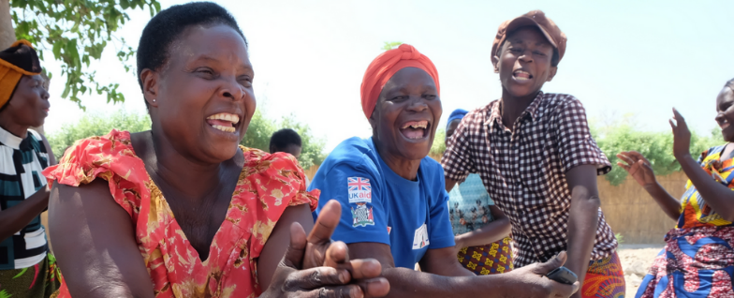

SDG 8
Decent work and economic growth
Target 8.3
SUGGESTION FROM THE CLIENTS
Promote development-oriented policies that support productive activities, decent job creation, entrepreneurship, creativity and innovation, and encourage the formalisation and growth of micro-, small- and medium-sized enterprises, including through access to financial services
  Payment period should be reconsidered (11,6%)
  Thankful for FSP ABC help in their family and community
  Would like to borrow more (15.6%)
  The interest are too high especially for the agricultural loan (15.6%)
NUMBER OF SMES FORMALISED (TRACKING CHANGES)
xx%
of the client created a new business with the loan given
xx%
of the client developed an existing business with the loan given
xx%
of the client have increased the work force (one or more extra staff) in the last 2 years
CHANGES IN BUSINESS REVENUE :
1) ANNUAL SALES 2) ANNUAL NET INCOME
Very much improved
37.5%
I'm happy because households are happy! I have friends and no more discrimination by people who want us wrong.
The client’s business income has:
Improved
51.8%
No change
1.8%
Decreased
8.9%

